Slide 1

MSPM’s Deogiri Institute of Engineering and Management Studies, Aurangabad
Academic Year 2018-19
Department of Second Year Engineering.
Subject: Machine Learning
Topic: Heart Attack Prediction
Git-Hub Link: https://github.com/sakshiyedatkar8
Submitted By:
Sakshi Sanjay Yedatkar(36027)
Under the Guidance Of
S. G. Nandedkar
Asst. Prof. Department of CSE
(Deogiri Institute Of Engineering and Management Studies)

Slide 2
In this we will be able to predict the chances of a person of getting a heart attack.
Dataset Used :
The dataset which is used is named as Framingham.
In this dataset the columns are male, age, education, current smoking, cigars per day, diabetes and many more.

Slide 3
Algorithm Used :
Logistic regression will be used to carry out this prediction.
It will classify if any heart disease will occur or not into yes or no.

Slide 4
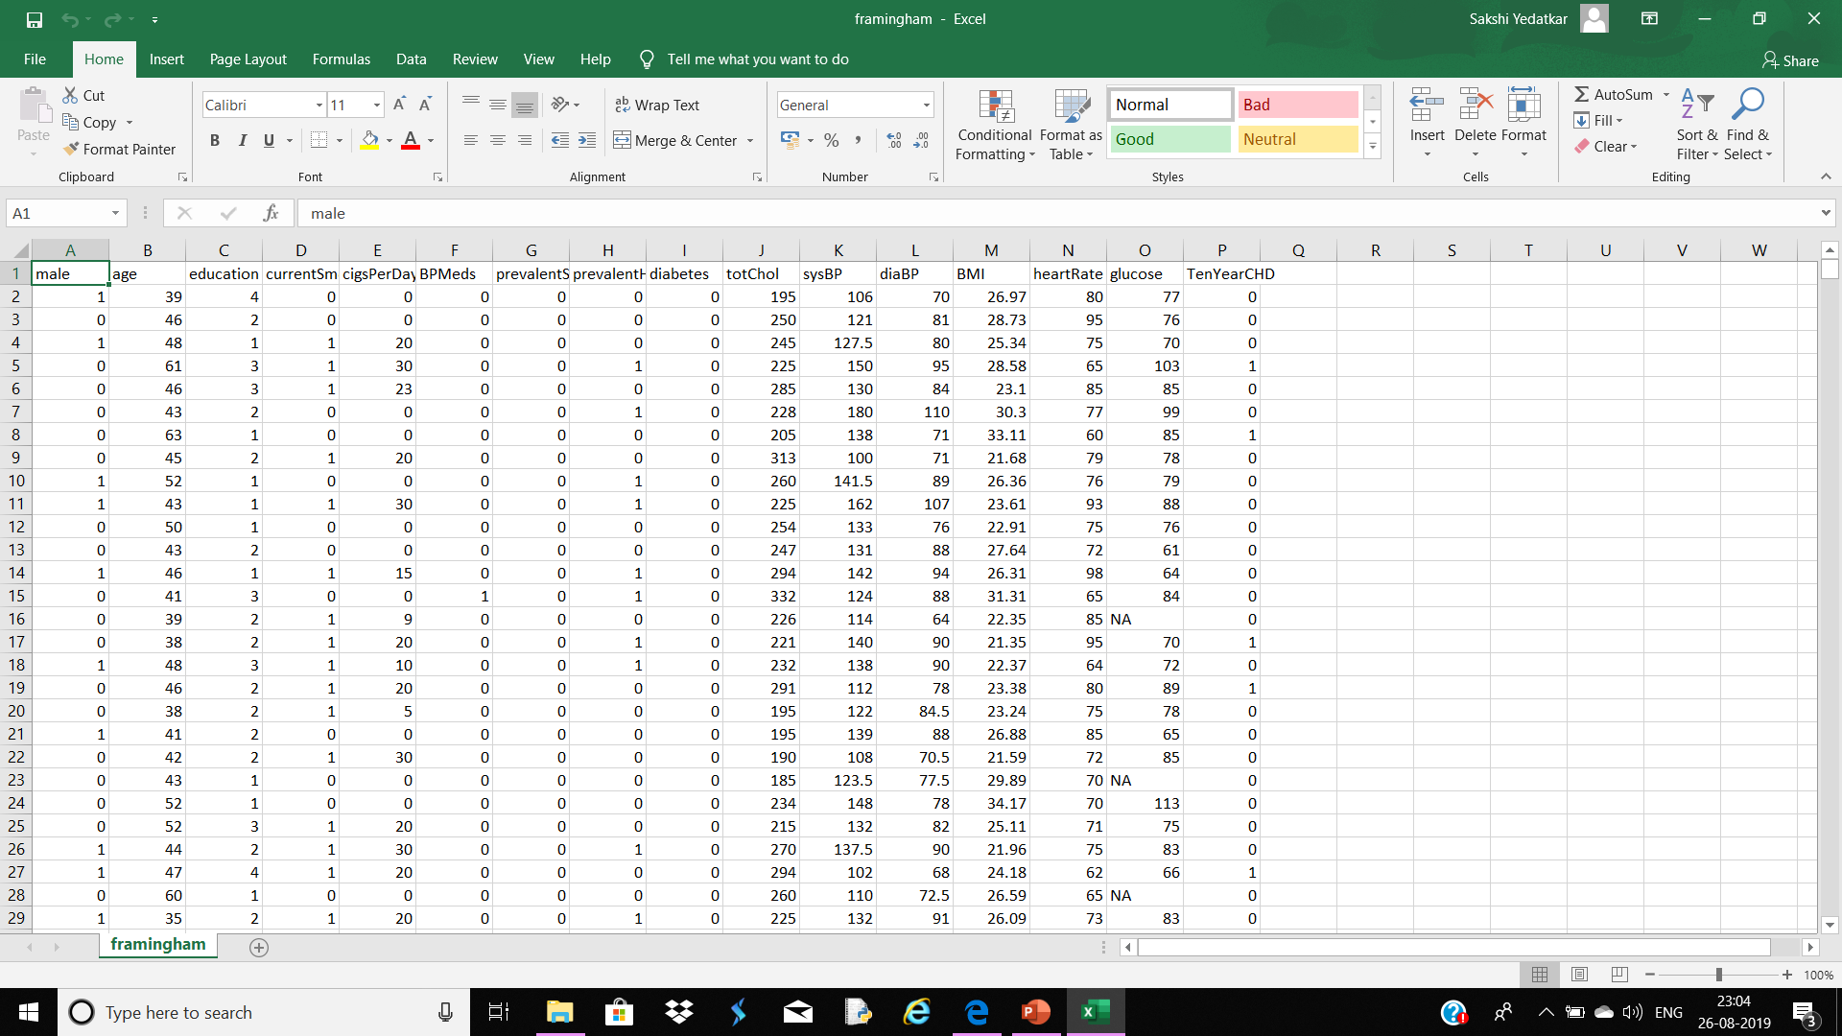
This is the Dataset :

Slide 5


